Slide 1
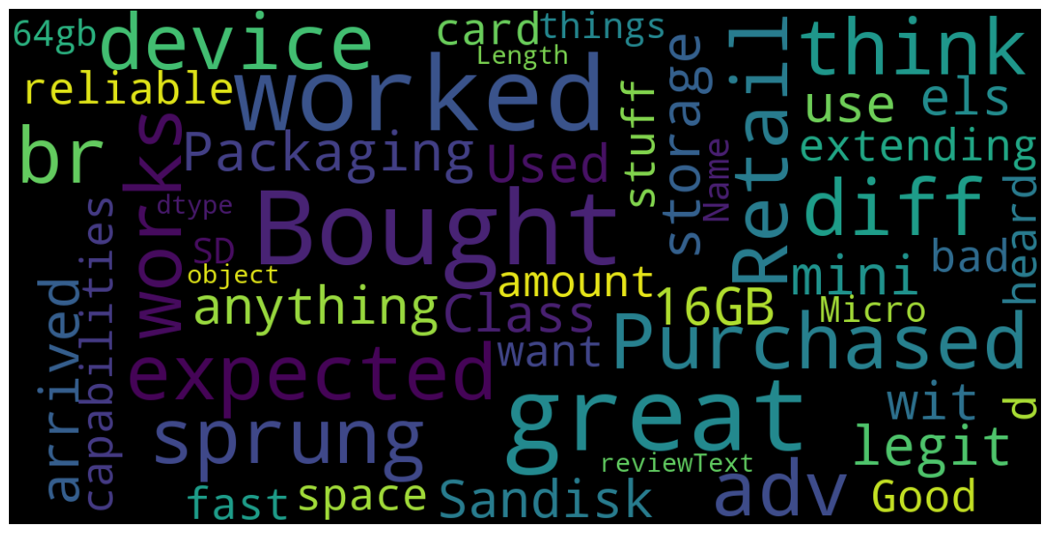
Anastasiia Leskiv

Slide 2

Project overview
Objective
Develop advanced machine learning models to accurately categorize customer reviews as satisfied or dissatisfied based on their content.
Key Focus
Identify and spotlight the most impactful reviews that require immediate attention.
Notes:
Everyday in our life we are buying different products, we have a huge selection under one category. It's always hard to decide what brand or type of the product to choose. Here where reviews help us to make that dessision.Customers who have already purchased a product share their experiences by providing ratings and detailed reviews.I analyzed the reviews provided by customers. I used machine learning and deep learning models to create a predictive model. Those models will determine whether customers are satisfied or dissatisfied with the product based on their reviews. My model would help manufacturers to make their products better by incorporating customer feedback and suggestions.

Slide 3
Business and Data Understanding For the best result I used : -Data Collection -Data cleaning -Exploratory Data Analysis -Modeling -Evaluation -Code Quality -Visualization Client-Focused Insights : 1. Most Helpful Reviews 2. Manufacturer Support 3. Key Analysis Focus 4. Product Review Distribution
Notes:
This dataset containing Amazon Product Data The product with the most comments in the electronics category has user ratings and comments.

Slide 4
Data
- User Name
-Product Rating -Evaluation Summary
-Evaluation Time
-Number of days since assessment
-Product Rating
-Number of people who didn't support the comment and didn't find it helpful
-The number of times the evaluation was found useful
-Number of votes given to the evaluation
- Score average rating

Slide 5
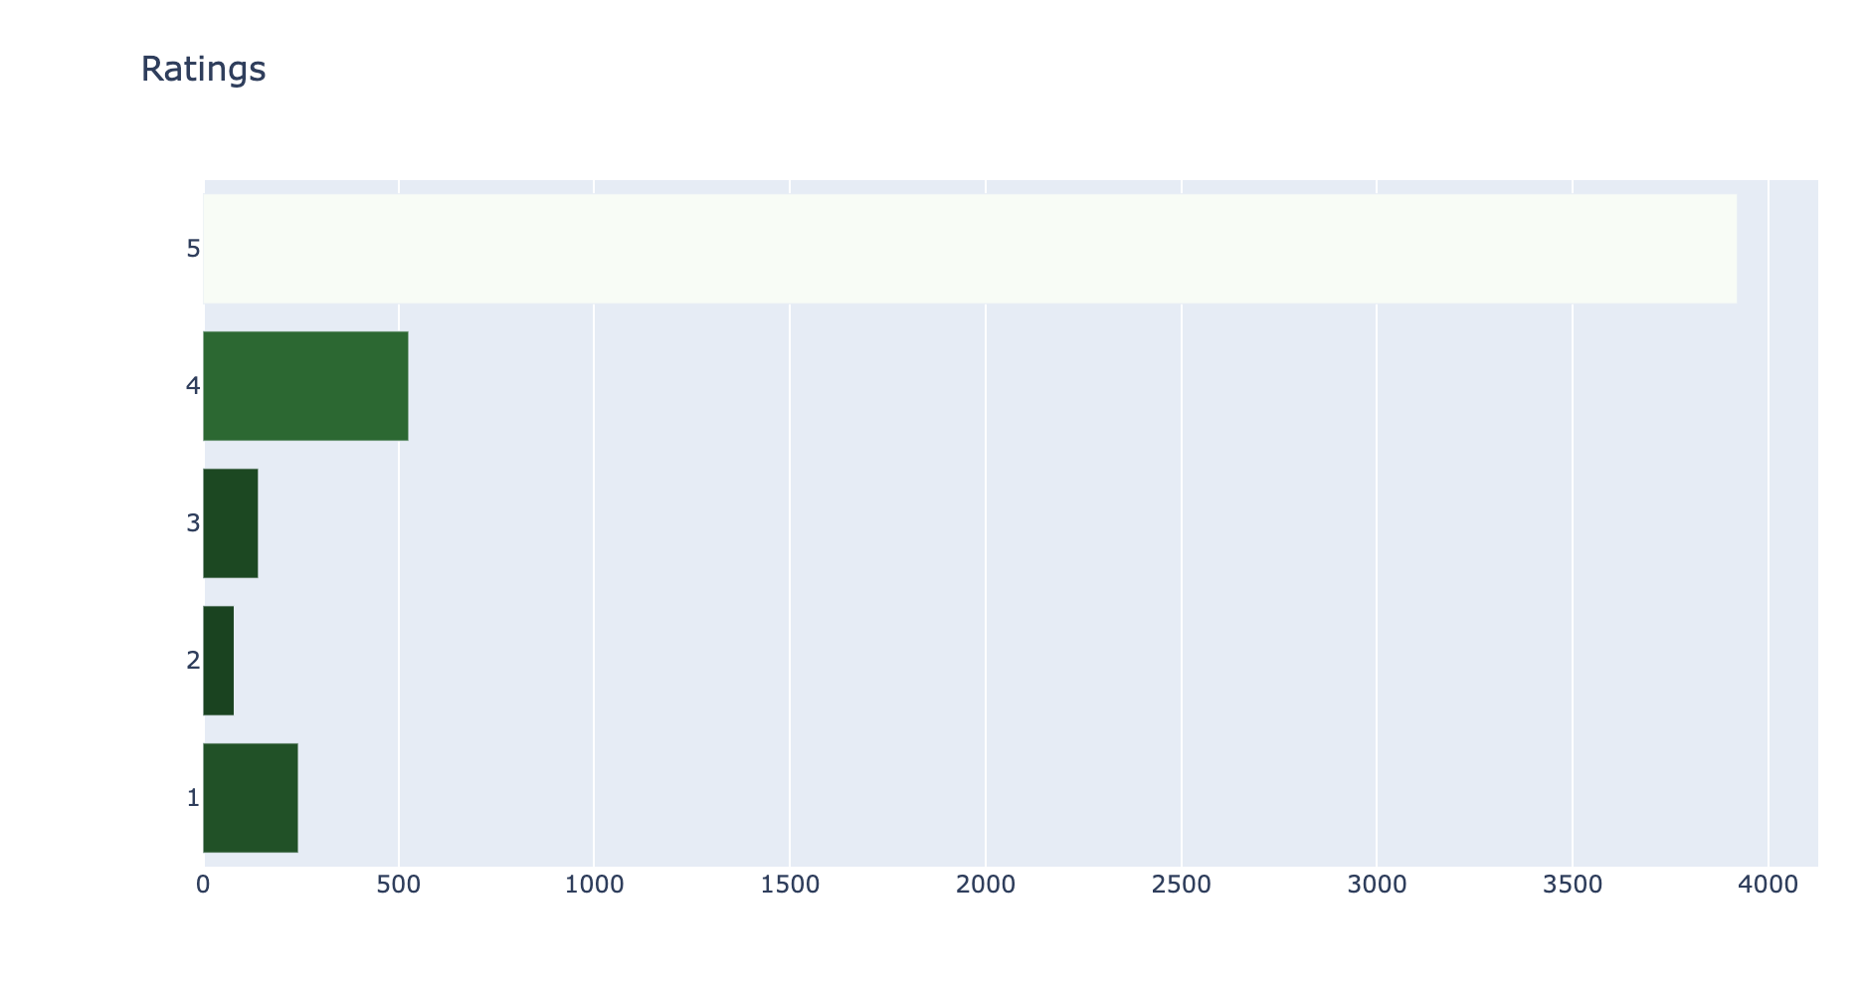
Most of the reviews are 5 stars - 3921
Notes:
In this visualization I want to show how many reviews in each category from 1 to 5 stars review
5 stars review - 3921
4 stars review - 526
3 stars review - 142
2 stars review - 80
1 stars review - 244

Slide 6
The most used words in this dataset
Notes:
Here in this visualization, we can see the most used words in this dataset

Slide 7
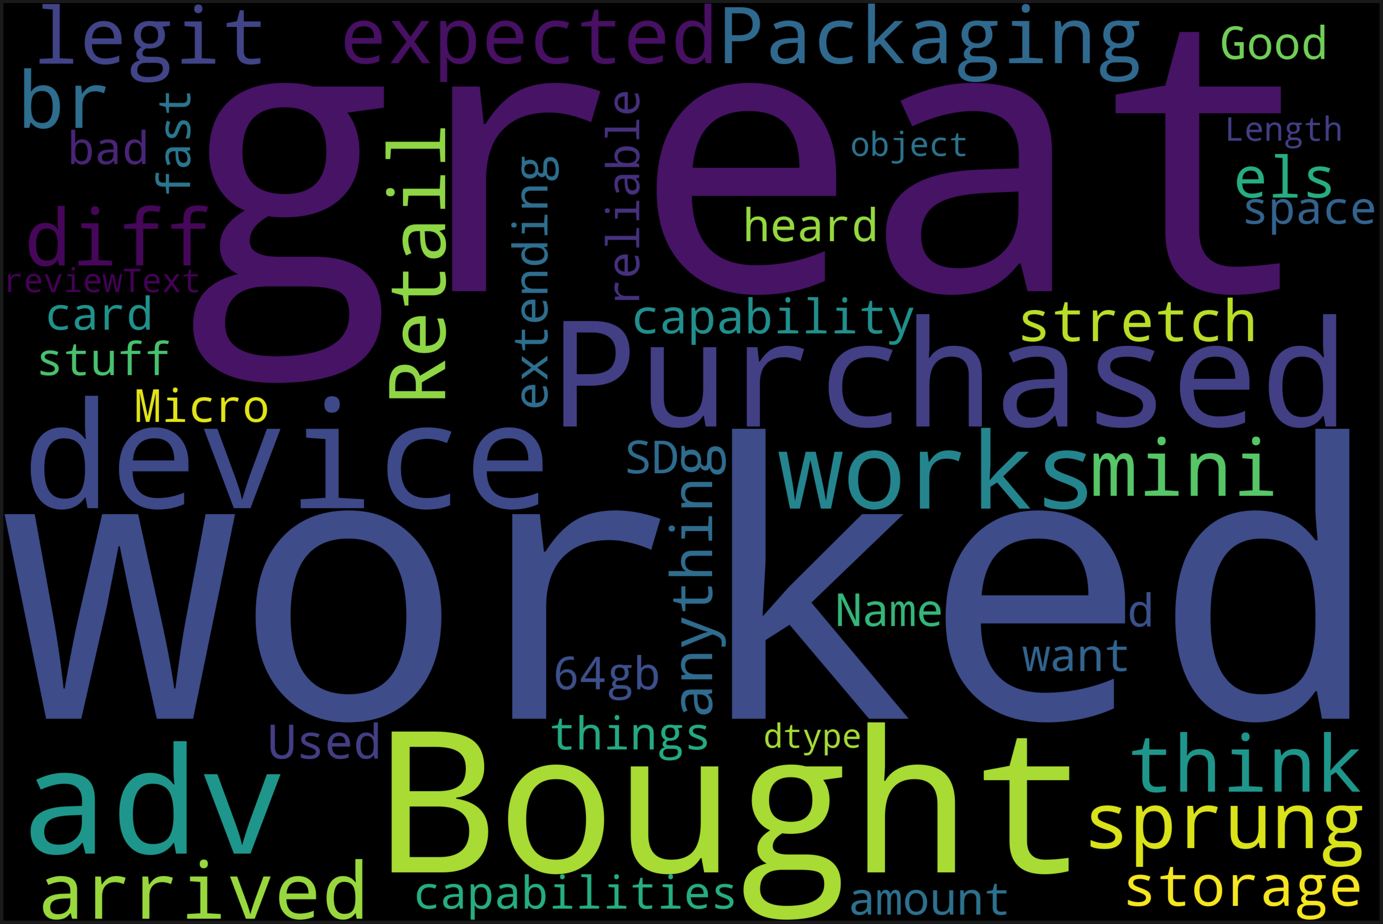
Common words in positive reviews
Notes:
Here in this visualization, we can see the most common words in positive reviews

Slide 8
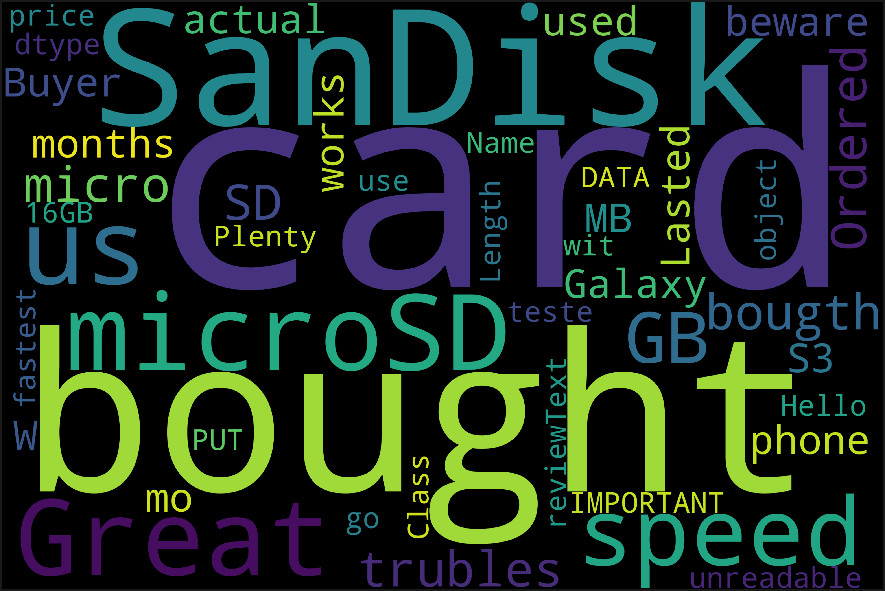
Common words in negative reviews
Notes:
Here in this visualization we can see the most common words in negative reviews

Slide 9
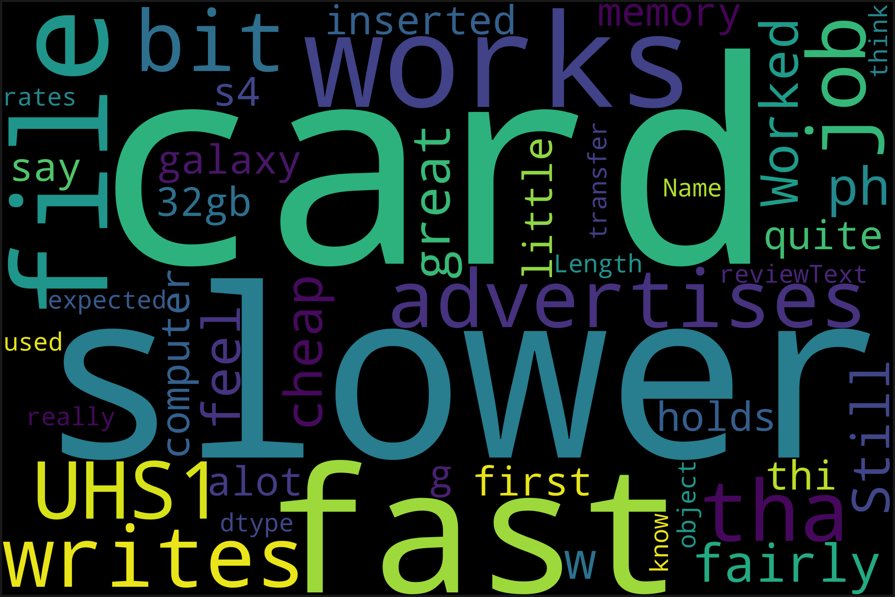
Common words in good (3stars) reviews
Notes:
Here in this visualization we can see the most common words in good (3stars) reviews

Slide 10
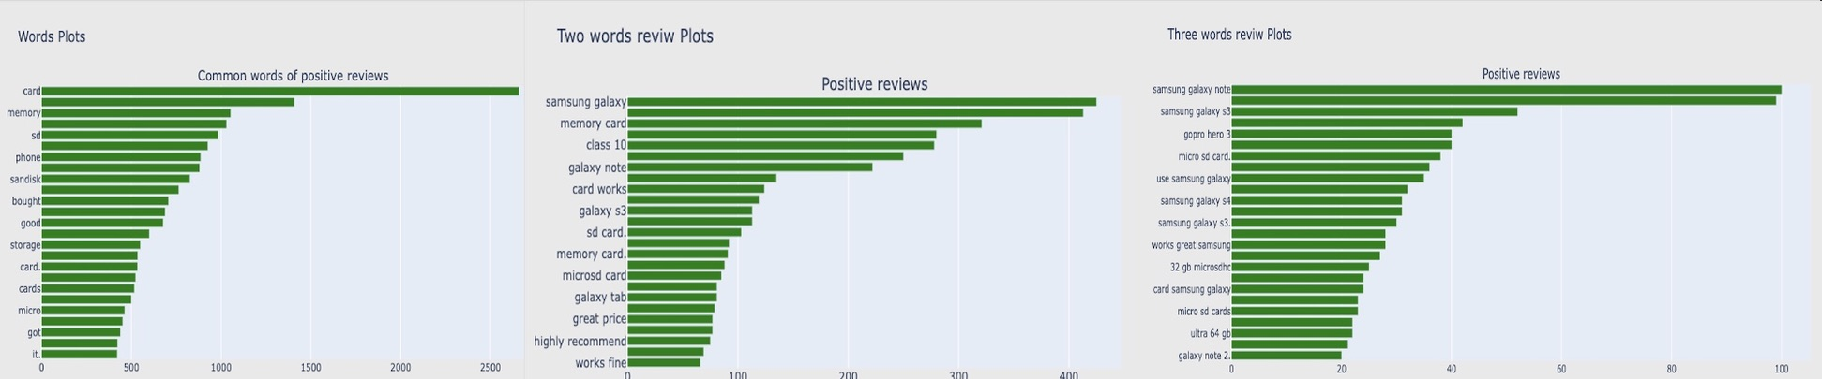
Most used words for positive reviews section with 1 word, 2 words, and 3 words

Slide 11
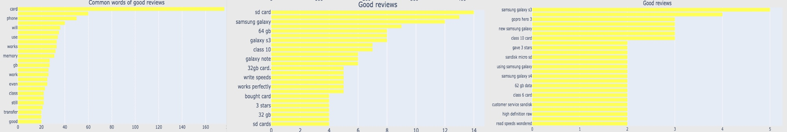
Most used words for good reviews section with 1 word, 2 words, and 3 words

Slide 12
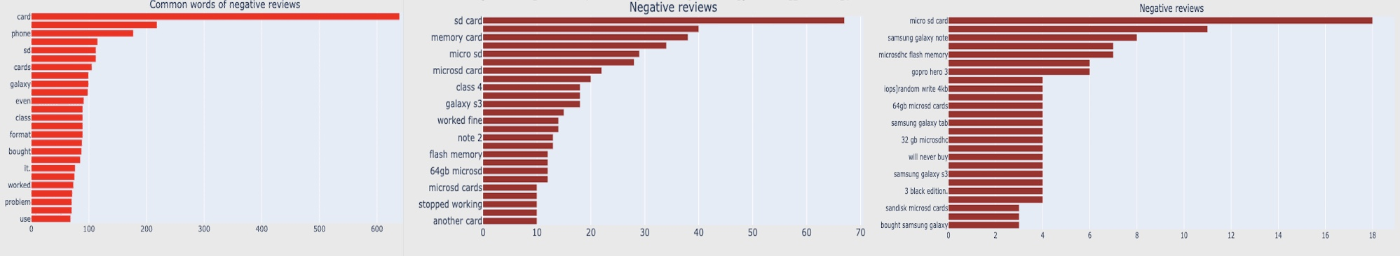
Most used words for negative reviews section with 1 word, 2 words, and 3 words

Slide 13
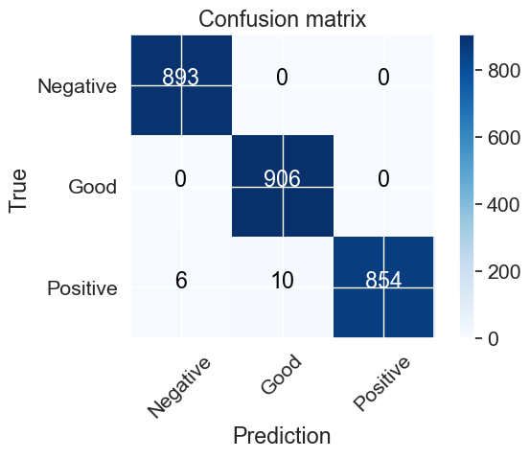
Logistic Regression with Hyperparameter Tuning model for Confusion Matrix Analysis
See the diagonal elements (893, 906, 854), we observe that they represent correctly predicted records
Notes:
See the diagonal elements (893, 906, 854), we observe that they represent correctly predicted records, while the rest correspond to instances that were incorrectly classified by the algorithm. This highlights the importance of evaluating not only accuracy but also other metrics like precision, recall, and the F1 score to gain a comprehensive understanding of the model's performance.

Slide 14
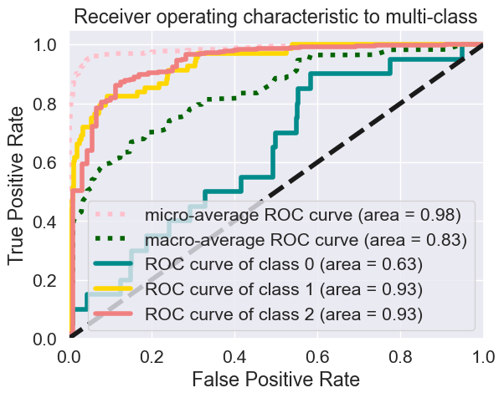
Class 2 and Class 1 excel with high AUC values, highlighting Logistic Regression with Hyperparameter Tuning model’s strong performance. These insights drive informed decisions and guide strategic tuning for specific objectives.
Notes:
ROC-AUC curve The Receiver Operating Characteristic (ROC) curve is indeed a critical tool when dealing with classification tasks involving multiple classes. By plotting ROC curves for each class, we can determine how well the model discriminates between the different sentiment categories.
The micro and macro averages on the ROC curve are also essential. The micro-average considers all instances individually, regardless of their class labels. It's useful when all classes are equal importance. The macro-average, on the other hand, calculates the average performance across all classes. This gives us a seance of overall model performance, which is crucial when different classes have varying degrees of importance.
It's great to see that class 2 and class 1 have been classified effectively, as indicated by their high area under the curve (AUC) values. This suggests that the model performs well in distinguishing these classes.
The ROC curve provides a range of values that can be chosen to balance true positive rate (TPR) and false positive rate (FPR) based on the specific requirements of the task.
we can also look at Micro and Macro Averages:
Micro-average is performing well, indicating an aggregate measure that considers all classes and is beneficial when class imbalance is suspected.
Macro-average computes the metric independently for each class and then takes the average, treating all classes equally. In this case, it appears to have a lower score, suggesting that the model's performance may vary across different classes.
These insights provide a clear understanding of how well the model is performing for different classes and the overall classification task. They help in making informed decisions about the choice of thresholds and understanding the impact of class imbalance on the evaluation metrics.

Slide 15
- Recognizing that many good reviews were criticism or feedback from buyers is a valuable insight.
-This feedback can be shared with sellers to help them improve their products.
- Good(3 stars) reviews are the most valuable.
-Most of the reviews were on electronics such as phones, Samsung galaxy, GoPro, cards.
Notes:
Conclusion
Recognizing that many good reviews were actually criticism or feedback from buyers is a valuable insight. This feedback can be shared with sellers to help them improve their products. Most of the reviews were on electronics such as phones, samsung galaxy, GoPro, cards ets.
Concentrating on the F1 score in sentiment analysis is highlighted, and achieving an average of 99% demonstrates the effectiveness of the model in both precision and recall.

Slide 16
Sentiment analysis using sentiment word dictionaries has low reliability when the number of positive and negative words is small.
Sentiment analysis using sentiment word dictionaries has low reliability when the number of positive and negative words is small.
Notes:
Sentiment analysis using sentiment word dictionaries has low reliability when the number of positive and negative words is small. For example, if there are 0 positive words and 1 negative word, it is classified as negative. if the number of sentiment words is 5 or less, we could exclude the observations.

Slide 17
Pay attention to good reviews(3 stars reviews)
Notes:
My recommendation is to pay attention to good reviews(3 stars reviews) . These are the most helpful and will help manufacturers to make their products better by incorporating customer feedback and suggestions.

Slide 18
Explore 3 stars reviews more to have specific recommendations to my client.
Notes:
My next step would be to explore 3 stars reviews more , to have specific recommendations to my client

Slide 19
Anastasiia Leskiv
Linkedin
Email: prokopivanastasiia@gmail.com
GitHub

